Slide 1

STES’s
NBN Sinhgad School of Engineering, Ambegaon, Pune-41
A Presentation on
“Experimental Investigation and Thermal Analysis of Solar Still”
By
Mr. Prasad C. Kakade [B121050885]
Mr. Atharva C. Kale [B121050886]
Mr. Amar R. Kakade [B121050884]
Mr. Amol M. Gaikwad [B121050857]
Under the Guidance of
Prof. B. L. Patil
Prof. R. K. Nanwatkar
Department Of Mechanical Engineering
NBN Sinhgad School of Engineering, Ambegaon (Bk), Pune-411041 [2017-18]

Slide 2
CONTENTS
INTRODUCTION
PROBLEM STATEMENT
SCOPE & OBJECTIVES
LITERATURE SURVEY
DESIGN CONSIDERATION & MATERIAL USED
FACTORS AFFECTING PERFORMANCE
TECHNIQUES USED TO INCREASE PERFORMANCE
ACTUAL MODEL
RESULTS
COMPARISON
CONCLUSION
FUTURE SCOPE
REFERENCES

Slide 3
INTRODUCTION
Two major challenges for human society today are shortage of fresh water and conventional energy sources.
Solar still is the best method to convert saline, brackish water into fresh water using the unconventional source of energy.
In this project we are comparing two most effective solar still designs and choosing one over other based on its advantages.
The design will play crucial role in various regions which have shortage of water with abundance of solar energy.

Slide 4
PROBLEM STATEMENT
About 97% of sea water is salt water which exists in various form like chloride, sodium, etc.
Various technologies exist but they are not cost effective.
Need of simple, affordable and sustainable design.

Slide 5
SCOPE & OBJECTIVES
To design and develop a solar still.
To improve the productivity of solar still using different phase change materials.
To perform thermal analysis of solar still.
To choose most effective solar still design.

Slide 6
LITERATURE SURVEY
Sr.No. | Authors name | Title | Year | Workdone
1. | H. Sharon , K.S. Reddy. | Experimental performance investigation of tilted solar still with basin and wick for distillate quality and enviro-economic aspects | 27 Jan 2017 | Assess the performance, distillate quality, environmental benefits and economic feasibility of solar still.
2. | R. Prakash, K. Srithar. | Mathematical and experimental investigation on the influence of basin height variation and stirring of water by solar PV panels in solar still | 15 April 2017 | The impact of height variation between the saline water surface and glass cover in solar still is theoretically and experimentally analyzed in this work.
3. | Hamdy Hassan, Saleh Abo-Elfadl | Effect of the condenser type and the medium of the saline water on the performance of the solar still in hot climate conditions | 12 May 2017 | The influence of the condenser type and saline water medium in the basin of the solar still on its performance is performed experimentally

Slide 7
DESIGN CONSIDERATION
Design objectives for solar still
Two basic methods
Active Type
Passive Type
Problems with solar still design and their solutions

Slide 8
MATERIALS AND INSTRUMENTS
Material used for model – Wood, Thermocol, Glass, GI sheet, Pipes, Sealing material
Instruments used for increasing performance – Solar panel, Battery, Water pump, Switch, Phase Change Materials
Instruments used for measurement – Digital Thermometer, Measuring Flask

Slide 9
Factors Affecting The Performance Of Solar Still
Glass- water temperature difference:-
1. Increased temperature difference leads to increase in circulation of air mass inside solar still.
2. It increases evaporative and convective heat transfer from basin water to glass cover.
3. It acts as a driving force for condensation.
Free surface area and deepness of water:-
1.Increased surface area of basin water increases the solar still productivity.
2.The water deepness of 5-7mm gives the highest yield.

Slide 10
Inlet water temperature:-
1. The saline water temperature controls the evaporation rate as evaporation increases with the temperature.
2. The evaporation rate is directly proportional to the water free surface area.
Environmental air temperature:-
1. Reducing environmental air temperature increases the glass-water temperature difference and hence productivity.
Wind velocity:-
1. Increased wind velocity increases the heat losses to surroundings thus reduces the productivity.

Slide 11
Angle, thickness and material for glass cover:-
1. Solar still yield reached a maximum value at when condensing glass cover inclination is equal to latitude of the place.
Type of Phase change material:-
1. The different phase change materials having different properties affect the productivity of solar still.
Insulation solar still:-
1. The material used for insulation of solar still have great impact on its productivity.

Slide 12
Techniques used to improve the performance of solar still
Using phase change material:-
1. PCM use the principle of latent heat storage for productivity enhancement.
2. They store the energy as latent heat during phase change and release the same energy during next phase change to original phase.
Stepped type solar still:-
1. A smaller air volume trapped inside still chamber than conventional still and therefore heating of trapped air will be faster.
2.The step-wise basin provides higher heat and mass transfer surface area than flat basin.

Slide 13
Solar Pump:-
Recirculation of hot water inside solar still increases the productivity .
As it works on solar energy, it does not require any other energy source.

Slide 14
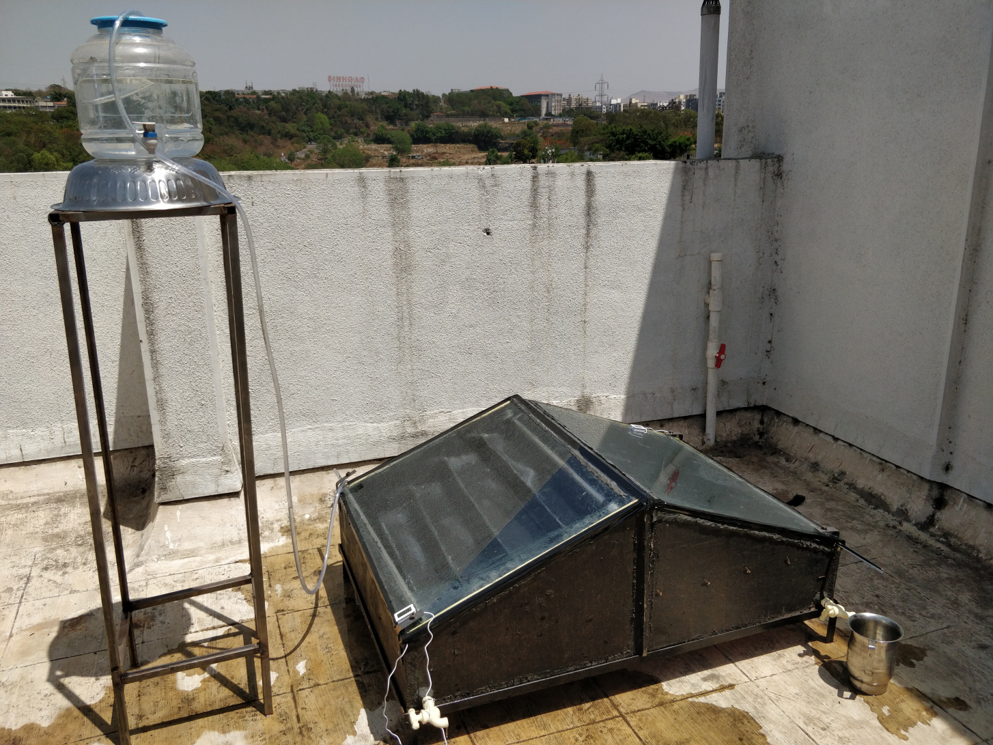
ACTUAL MODEL

Slide 15
RESULTS
1) Result Without PCM (Basin Type)

Slide 16
2) Result With PCM (Basin Type)

Slide 17
3) Result Without PCM (Stepped Type)

Slide 18
4) Result With PCM (Stepped Type)

Slide 19
COMPARISON
Stepped Type Solar Still | Basin Type Solar Still
Complex design | Easy to design and manufacture
More chances of leakages than basin type | Less leakage loss
High construction and maintenance cost | Low initial and maintenance cost
Less storage capacity of water | More storage capacity of water
Thin layer of water is obtained on each step which helps in faster evaporation of water | Easy to relocate
Water vapour has to travel less distance | More inner area so water vapour has to travel more distance
Less time consuming | More time consuming
It is highly efficient | Less efficient
As the area of contact with surface is more the heat generating capacity increases | Less heat generating capacity due to minimum area of contact with surface

Slide 20
CONCLUSION
The maximum productivity obtained was 130ml at 84ºC temperature at 14 Hrs.
Stepped type solar still is more effective than basin type for same ambient temperature
The performance of solar still gets affected by design parameters like basin area, orientation of still, depth of water, temperature of inlet water, water glass temperature difference
Active method is more effective than passive method

Slide 21
FUTURE SCOPE
For large scale production the devices such as collector with tracking devices and reflectors are used
Creating vacuum inside solar still will increase heat transfer rate
Preheating and recirculation of water in combination with another plant
Use of strainers and filters before admitting water to solar still will reduce its work

Slide 22
REFERENCES
Hamdy Hassan, Saleh Abo-Elfadl has experimented on “Effect of the condenser type and the medium of the saline water on the performance of the solar still in hot climate conditions”(May 2017).
T. Rajaseenivasan, R. Prakash, K. Vijayakumar, K. Srithar has worked on “Mathematical and experimental investigation on the influence of basin height variation and stirring of water by solar PV panels in solar still”(April 2017).
H. Sharon , K.S. Reddy , D. Krithika , Ligy Philip have worked on “Experimental investigation of tilted solar still with basin and wick for distillate quality and enviro-economic aspects”(January 2017).

Slide 23


